Slide 1

2022 Online
HYSPLIT Workshop
Wrap-Up
Workshop Web Page:
https://www.ready.noaa.gov/register/HYSPLIT_hyagenda.php
NOAA Air Resources Laboratory
June 14-17, 2022
Notes:
Hello, and welcome the 2020 HYSPLIT Workshop, being held entirely online this year. Some of you are watching live, and we hope that you have been able to join the event, and can hear us and can see what we are presenting. And some of you are watching a recording of the event, and we hope that your access to the recording is good. You are all in listen-only mode, and while you can see us, we cannot see you. To start us off, Dr. Ariel Stein, the Deputy Director of the NOAA Air Resources Laboratory, would like to welcome you.

Slide 2
2022 HYSPLIT Workshop Schedule
Subject to change, depending on the progression of the course and at the discretion of the instructors
UTC | Eastern Daylight Time | Monday June 13, 2022 | Tuesday June 14, 2022 | Wednesday June 15, 2022 | Thursday June 16, 2021 | Friday June 17, 2021
13:00 - 14:00 | 9:00 - 10:00 | OPTIONAL* 1a. Installing HYSPLIT on Windows PC | Introduction | Introduction | Introduction | Introduction
 |  |  |  | 7. Air Concentration calculations | 11. Pollutant transformations and deposition | 15. Radioactive pollutants and dose
 |  |  | 3. Gridded Meteorological Data Files
 |  | Break
14:00 - 15:00 | 10:00 - 11:00 | OPTIONAL* 1b. Installing HYSPLIT on MAC
 |  |  | Break |  | Break
 |  | Break | 4. Trajectory Calculations |  | 12. Air Concentration Uncertainty
 |  |  |  | Break |  | Break
15:00 - 16:00 | 11:00 - 12:00 | One-on-one virtual installation sessions, by appointment |  | 8. Configuring the CAPTEX simulation |  | 16. Volcanic eruptions with gravitational settling
16:00 - 17:00 | 12:00 - 13:00 | One-on-one virtual installation sessions, by appointment | Break |  | Break
 |  |  |  | Break |  | Break
17:00 - 18:00 | 13:00 - 14:00 | One-on-one virtual installation sessions, by appointment | 5. Trajectory Options |  | 13. Source Attribution Methods
 |  |  |  | 9. Air concentration parameter sensitivity |  | 17. Custom Simulations
18:00 - 19:00 | 14:00 - 15:00 | One-on-one virtual installation sessions, by appointment
 |  |  | Break
 |  |  | 6. Trajectory Statistics |  |  | Break
 |  |  |  |  | Break | Final Questions and Course Wrap-Up
19:00 - 20:00 | 15:00 - 16:00 | One-on-one virtual installation sessions, by appointment |  | Break | 14a. Wildfire Smoke
 |  |  |  | 10. Alternate display options
 |  |  | Day 1 Wrap-Up |  | 14b. Dust Storms
20:00 - 21:00 | 16:00 - 17:00 | One-on-one virtual installation sessions, by appointment |  | Day 2 Wrap Up
 |  |  |  |  | Day 3 Wrap Up
 |  |  |  | Day 2 Wrap Up
Notes:
* The pre-Workshop installation sessions on Monday June 13, 2022 from 9 - 9:45 AM (EDT) for Windows PC and from 10 - 10:30 AM EDT for MAC are optional. We recommend all participants attempt to install the HYSPLIT model and associated software before the Workshop starts, according to instructions posted here. This may require assistance from your local IT support.

Slide 3
HYSPLIT Model
Dispersion via 3-D puffs that grow and split horizontally and vertically as they are transported downwind
Continuous development at NOAA Air Resources Laboratory (ARL) for more than 40 years
ARL HYSPLIT modeling group (~10 scientists)
Trajectories and Dispersion
Forward and Backward
3-D Dispersion (generally > ~1 km):
  Puffs (top-hat or Gaussian)
  “Particles” (i.e., computational points)
  Eulerian grid
Dry and Wet deposition
Chemical and Radiological Transformations
Simulation Modes:
  Run online (READY)
  Download – run via Graphical User Interface
  Download – run via command line and scripts
  Windows, Mac, Linux
Users:
  Emergency response & science at NOAA
  Emergency response & science - other agencies (e.g., MACCS)
  Scientific community: e.g., Stein et al. 2015 ~ 3000 citations
Dispersion via assembly of 3-D computational particles that undergoing turbulent transport
z
+ y
x
- y
3
Notes:
I’m going to be providing a very brief overview of the HYSPLIT model and some of its new features and applications, but am not going to be going into any detail about exactly how it is currently used in MACCS
Collaborative exchanges between ARL and applications – e.g., MACCS – is a very important way that the HYSPLIT model is evaluated and improved.
===========================================
3D particle-based dispersion:
To simulate a plume from a source, we release many particles at a time, and this cloud of particles is transported downwind
Each computational point particle gets additional motion based on the amount of turbulence in the atmosphere.
Here we are showing just a few particles released at one time. In a real HYSPLIT run, you would release 100’s or 1000’s or even more particles at any given time.
If the pollutant release was ongoing, you would keep releasing particles from the source as long as you wanted to simulate the emissions.
As the wind changes speed and direction, and as the turbulence in the atmosphere changes, the plume will be dispersed in different directions and will be dispersed to different extents.

Slide 4
Extensive use of HYSPLIT by the research community
A. Stein, R. Draxler, G. Rolph, B. Stunder, M. Cohen, and F. Ngan (2015). NOAA’s HYSPLIT Atmospheric Transport and Dispersion Modeling System. Bulletin of the American Meteorological Society, 96: 2059
doi: 10.1175/BAMS-D-14-00110.1
Cumulative
# of
Citations
in Google Scholar
G. Rolph, A. Stein, and B. Stunder (2017).
Real-time Environmental Applications and Display sYstem: READY. Envr. Modelling and Software 95: 210 doi: 10.1016/j.envsoft.2017.06.025
+ ~80 other publications by ARL ATD group scientists from 2016-2021
Notes:
Another measure of Quality and Relevance is the number of citations of two recent HYSPLIT papers in peer-reviewed journal articles.
There have been more than 3000 citations of the 2015 HYSPLIT review article and more than 800 citations of the 2017 READY paper, as reported in Google Scholar, an extraordinarily high number of citations.
In most of these articles, the model is used by the authors in their scientific analysis, e.g., to interpret measurements.
And, on the topic of journal articles, ARL scientists working in this Theme area have published about 80 papers of our own in peer-reviewed journals during the 2016-2021 review period.
=====================================
Google Scholar statistics collected Jan 29, 2022.

Slide 5
HYSPLIT Resolution Overview
HYSPLIT is driven by gridded meteorological data, generally supplied as an “input”
  This gridded met data will have a temporal and spatial resolution that will affect the accuracy of the transport and dispersion simulation
  HYSPLIT interpolates in time and space between met model data grid points to try to estimate the met data at any location/time in the simulation domain
HYSPLIT simulations will have one or more concentration grids that are specified by the user
  These conc grids each have their own user-defined temporal, horizontal, and vertical resolution
  Resolution of the conc grids are independent and completely separate from the resolution of the met data grids
  Note – the same concentration grids are also used to track deposition
Minimum time step in HYSPLIT is 1 minute
  this governs transport & dispersion; deposition; and concentration outputs
  3 m/sec wind → 180 meters in 1 minute
  Interpolation routine in output algorithm fills in space between starting and ending position to avoid leap-frogging over concentration grid squares
  But, no met data finer than 1 minute is used
  In most cases, we do not have met data with temporal resolution of less than 1 minute… (exception: HYSPLIT in-line with WRF)
We are considering decreasing the minimum time step down to 1 second; this may offer some advantages for very near-field simulations
5

Slide 6
HYSPLIT Resolution: Concentration Grids
You can define more than one grid, each with its own specifications.
Depending on where the grid is and which way the wind is blowing during the simulation, you might not get any computational point particles in the grid, and all concentrations in the grid will be zero.
If a grid has very fine spacing, you might need to increase the number of computational point particles released in the simulation.
The particles are “discrete” and if there are too few of them, you aren’t really representing the continuous plume, and you can get very blotchy results.
z
grid #1
grid #2
x
+ y
- y
6

Slide 7
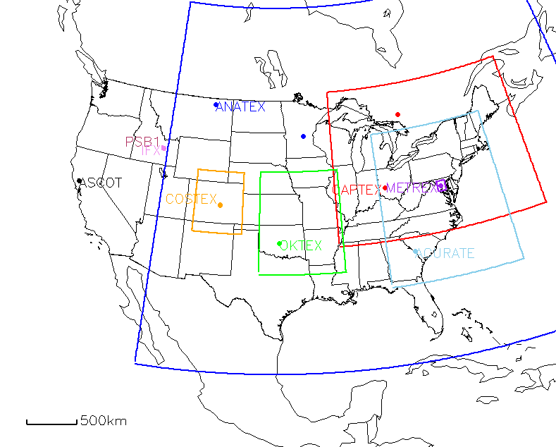
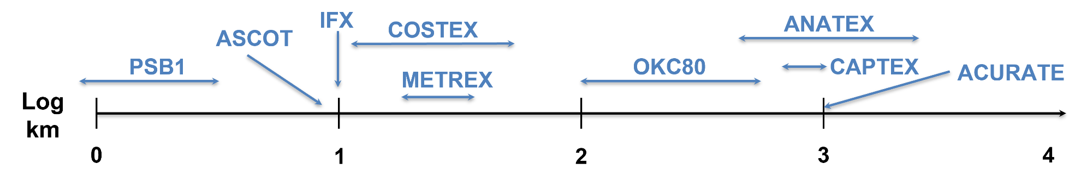
HYSPLIT Model Evaluation + Improvement with Tracers
Intentional Tracers
  Past tracer experiments → DATEM system
Experiments | Range (km) | Range (log km)
ACURATE | 1000 | 3.0
ANATEX | 500-2800 | 2.7-3.4
CAPTEX | 800-1000 | 2.9-3.0
OKC80 | 100-600 | 2.0-2.8
METREX | 20-30 | 1.3-1.5
COSTEX | 10-50 | 1-1.7
IFX | 10 | 1
ASCOT | 10 | 1
PSB1 | 0.2-3.2 | -0.7-0.5
Spatial scale (log km)
7

Slide 8
Model physics – selected recent updates
Model features – selected recent updates
Random numbers – turbulence treatments
  (2019) - Changed how turbulent velocity is initialized. New namelist variable VINIT = 1 (default) initializes turbulent velocity by drawing from distribution; VINIT = 0 initializes turbulent velocity to zero
Random numbers – non dispersion procedures
  (2020) new KRAND options for more user control over initial seeds for random number generation
Model vertical structures
  (2020) - Increased compatibility with WRF hybrid vertical coordinate system
  (2021) - More user control over model vertical levels
Buoyancy-driven plume-rise algorithms
  Existing: Briggs (based on point source observations)
  (2020) - New for wildfires: Sofiev
  (2022) - Upcoming for wildfires: Freitas
Dust emissions
  (2022) – Upcoming: FENGSHA algorithm
more functionality for polar concentration grids
  (2018) - Now works with puffs as well as particles
HYSPTEST program
  (2019) - Pre-processing program to test inputs and configuration to diagnose common errors
Center-of-Mass Trajectory option
  (2020) - Trajectory created based on center-of-mass of emitted computational particles (CMTFN)
Python post-processing graphics programs
  (2020) - Python versions have increased functionality, e.g., different map backgrounds, zooming features
SVG graphics outputs – as an alternative to postscript
  (2021) - Workaround for increasingly difficult Ghostscript / Ghostview compatibility issues
Density estimation via Gaussian Mixture Models
  (2020) Crawford, A: The Use of Gaussian Mixture Models with Atmospheric Lagrangian Particle Dispersion Models for Density Estimation and Feature Identification. Atmosphere 11:1369. doi:10.3390/atmos11121369
8
Notes:
KRAND = method to calculate random number
0=precompute if NUMPAR greater than 5000 or dynamic if NUMPAR less than or equal to 5000;
1=precalculated;
2=calculated in pardsp;
3=none;
4=random initial seed number and calculated in pardsp;
10=same as 0 with random initial seed for non-dispersion applications;
11=same as 1 with random initial seed for non-dispersion applications;
12=same as 2 with random initial seed for non-dispersion applications;
13=same as 3 with random initial seed for non-dispersion applications
KRAND (0) - same as KRAND=1 if NUMPAR is greater than 5000 or same as KRAND=2 if NUMPAR is less than or equal to 5000.
KRAND=1 precomputes all the random numbers required for the particle turbulence calculations.
KRAND=2 computes the random numbers at each dispersion time step. The dynamic method is slightly more accurate than the precomputed random numbers, but it requires about twice as much CPU time. With large particle release rates both methods will provide comparable results.
The special case of KRAND=3 will result in no turbulent mixing being added to the particle position; the particle track will follow the mean trajectory. This option is primarily intended for diagnostic testing.
The option KRAND=4 follows the STILT method of randomly selecting an initial seed number for the random number generator and compute these random numbers at each dispersion time step.
KRAND=0, 1, 2, and 3 uses the same initial seed number for non-dispersion applications (i.e., emissions placement, deposition, chemistry) to allow simulations to be repeatable.
KRAND=10, 11, 12, and 13 are the same as KRAND=0, 1, 2, and 3 except a random initial seed number is used for nondispersion procedures.
KRAND=4 also uses a random initial seed number for non-dispersion procedures.

Slide 9
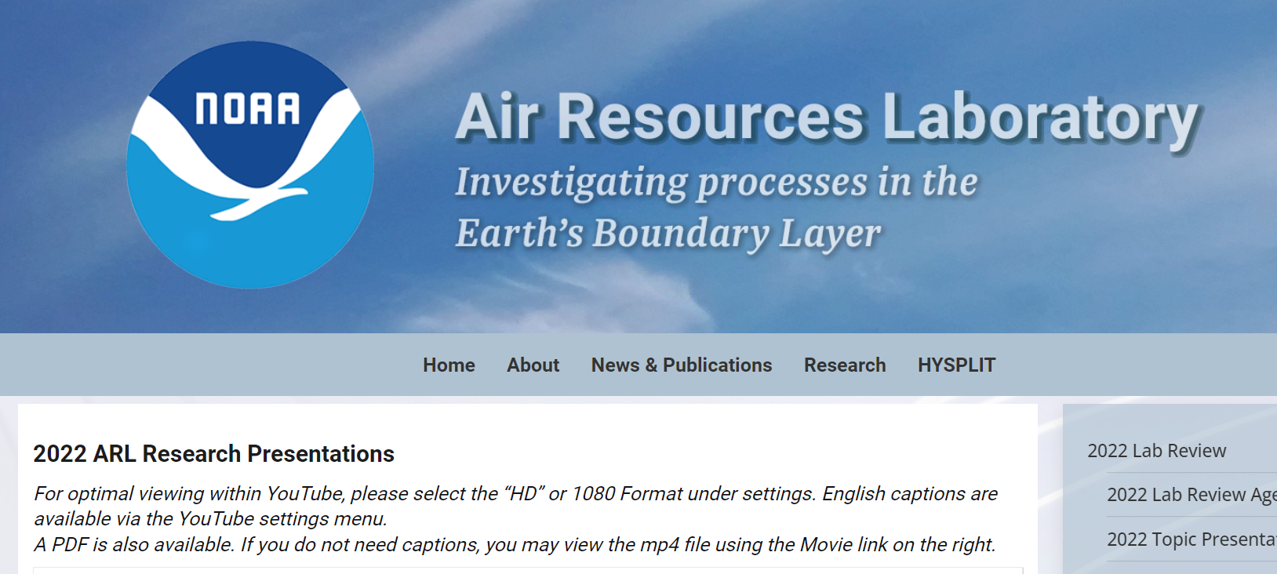
The NOAA Air Resources Laboratory recently had its 5-year science review
https://www.arl.noaa.gov/about/lab-reviews/2022-lab-review/2022-arl-review-topic-presentations/

Slide 10
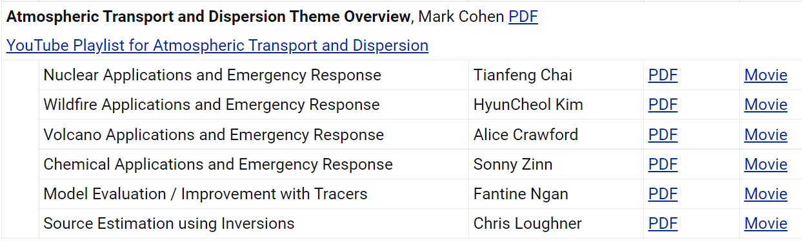
https://www.arl.noaa.gov/about/lab-reviews/2022-lab-review/2022-arl-review-topic-presentations/

Slide 11
HYSPLIT Tips
CONTROL file: Look at this file if you are having a problem – sometimes you can see obvious errors
GUI: When you are using the GUI, most input and output files will be in hysplit\working\
Scripts: usually create a new working directory, e.g., hysplit\working_nuclear\
Met File(s): Correct directory and name; encompass time & spatial domain of your desired simulation
Ascii text: CONTROL, SETUP.CFG, MESSAGE, TDUMP files (trajectory output files), scripts
Binary: Met data files, CDUMP files (concentration output files)
Options: Not all available from GUI; can type executable name from command line to see options
Met data archives: https://www.ready.noaa.gov/archives.php
Many other HYSPLIT programs in the HYSPLIT exec directory (e.g., met data analysis programs); some are available in the GUI, but not all
Graphics: HYSPLIT has some graphical capabilities – including some new Python and SVG graphics – but you can also display your model outputs using other graphics platforms (Google Earth, GIS, Python, Matlab...)
Numerical Experiments:
  Do you have enough particles in your simulation? Increase the number and see if your answers change. Keep increasing until the answers level off. The finer the grid you use, the more particles you need.
  Do the same simulation with different met data sets to evaluate sensitivity to met data uncertainties
  And you can do other sensitivity tests for other parameters
11
Notes:
KRAND = method to calculate random number
0=precompute if NUMPAR greater than 5000 or dynamic if NUMPAR less than or equal to 5000;
1=precalculated;
2=calculated in pardsp;
3=none;
4=random initial seed number and calculated in pardsp;
10=same as 0 with random initial seed for non-dispersion applications;
11=same as 1 with random initial seed for non-dispersion applications;
12=same as 2 with random initial seed for non-dispersion applications;
13=same as 3 with random initial seed for non-dispersion applications
KRAND (0) - same as KRAND=1 if NUMPAR is greater than 5000 or same as KRAND=2 if NUMPAR is less than or equal to 5000.
KRAND=1 precomputes all the random numbers required for the particle turbulence calculations.
KRAND=2 computes the random numbers at each dispersion time step. The dynamic method is slightly more accurate than the precomputed random numbers, but it requires about twice as much CPU time. With large particle release rates both methods will provide comparable results.
The special case of KRAND=3 will result in no turbulent mixing being added to the particle position; the particle track will follow the mean trajectory. This option is primarily intended for diagnostic testing.
The option KRAND=4 follows the STILT method of randomly selecting an initial seed number for the random number generator and compute these random numbers at each dispersion time step.
KRAND=0, 1, 2, and 3 uses the same initial seed number for non-dispersion applications (i.e., emissions placement, deposition, chemistry) to allow simulations to be repeatable.
KRAND=10, 11, 12, and 13 are the same as KRAND=0, 1, 2, and 3 except a random initial seed number is used for nondispersion procedures.
KRAND=4 also uses a random initial seed number for non-dispersion procedures.

Slide 12
HYSPLIT Documentation and Learning Resources
HYSPLIT Tutorial: detailed instructions on using the GUI + example scripts; can be run online or downloaded to local computer
The GUI is a great way to learn HYSPLIT
  even experienced users use it when trying something new
  can create a run in the GUI, and then look at associated input/output files to tell you how to to create a script to do similar simulations
  you can do some relatively complicated procedures (e.g., trajectory clustering)
HYSPLIT Users Guide: online (and also in hysplit/documents directory)
Download HYSPLIT and other resources: https://www.ready.noaa.gov/HYSPLIT.php
HYSPLIT Cheat Sheet
Model Overview: https://www.arl.noaa.gov/hysplit/hysplit/
Equations: https://www.arl.noaa.gov/wp_arl/wp-content/uploads/documents/reports/arl-224.pdf
HYSPLIT Forum: https://hysplitbbs.arl.noaa.gov/
HYSPLIT FAQ’s: https://www.arl.noaa.gov/hysplit/hysplit-frequently-asked-questions-faqs/
Recent HYSPLIT Training Workshop: https://www.ready.noaa.gov/register/HYSPLIT_hyagenda.php
Stein et al., 2015: NOAA’s HYSPLIT atmospheric transport and dispersion modeling system, Bull. Amer. Meteor. Soc., 96, 2059-2077, http://dx.doi.org/10.1175/BAMS-D-14-00110.1
Rolph et al., 2017: Real-time Environmental Applications and Display sYstem: READY. Environmental Modelling & Software, 95, 210-228, https://doi.org/10.1016/j.envsoft.2017.06.025
12
Notes:
KRAND = method to calculate random number
0=precompute if NUMPAR greater than 5000 or dynamic if NUMPAR less than or equal to 5000;
1=precalculated;
2=calculated in pardsp;
3=none;
4=random initial seed number and calculated in pardsp;
10=same as 0 with random initial seed for non-dispersion applications;
11=same as 1 with random initial seed for non-dispersion applications;
12=same as 2 with random initial seed for non-dispersion applications;
13=same as 3 with random initial seed for non-dispersion applications
KRAND (0) - same as KRAND=1 if NUMPAR is greater than 5000 or same as KRAND=2 if NUMPAR is less than or equal to 5000.
KRAND=1 precomputes all the random numbers required for the particle turbulence calculations.
KRAND=2 computes the random numbers at each dispersion time step. The dynamic method is slightly more accurate than the precomputed random numbers, but it requires about twice as much CPU time. With large particle release rates both methods will provide comparable results.
The special case of KRAND=3 will result in no turbulent mixing being added to the particle position; the particle track will follow the mean trajectory. This option is primarily intended for diagnostic testing.
The option KRAND=4 follows the STILT method of randomly selecting an initial seed number for the random number generator and compute these random numbers at each dispersion time step.
KRAND=0, 1, 2, and 3 uses the same initial seed number for non-dispersion applications (i.e., emissions placement, deposition, chemistry) to allow simulations to be repeatable.
KRAND=10, 11, 12, and 13 are the same as KRAND=0, 1, 2, and 3 except a random initial seed number is used for nondispersion procedures.
KRAND=4 also uses a random initial seed number for non-dispersion procedures.

Slide 13
Workshop guidance
and resources posted at
Workshop Web Page
https://www.ready.noaa.gov/
register/HYSPLIT_hyagenda.php
We will update this page to include any new materials or links that are relevant to the Workshop

Slide 14
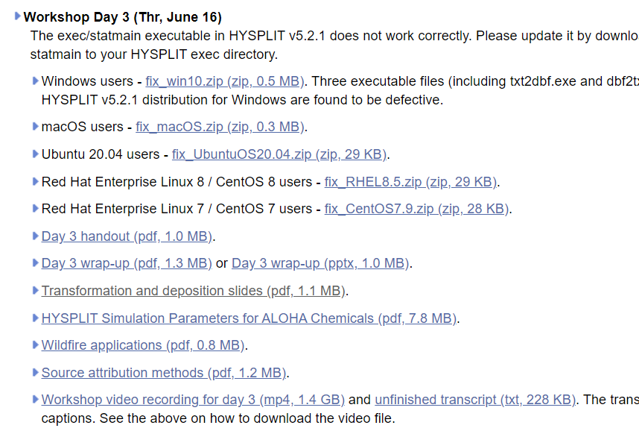
https://www.ready.noaa.gov/register/HYSPLIT_hyagenda.php

Slide 15
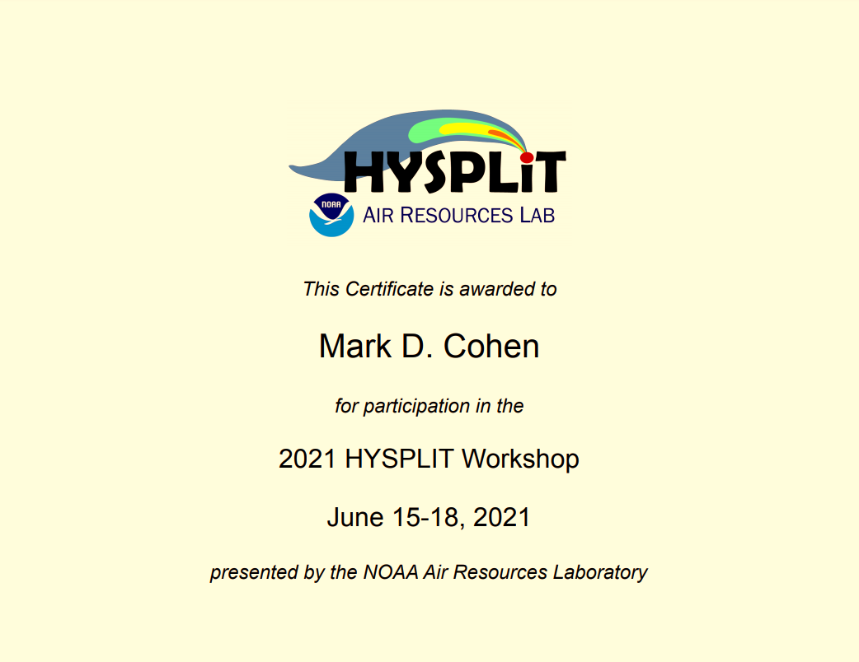
Course Certificates
Course certificates will be made available to all participants
You will receive an email (probably next week) asking if you would like a certificate and letting you know how to obtain it
2022 HYSPLIT Workshop
June 14-17, 2022

Slide 16
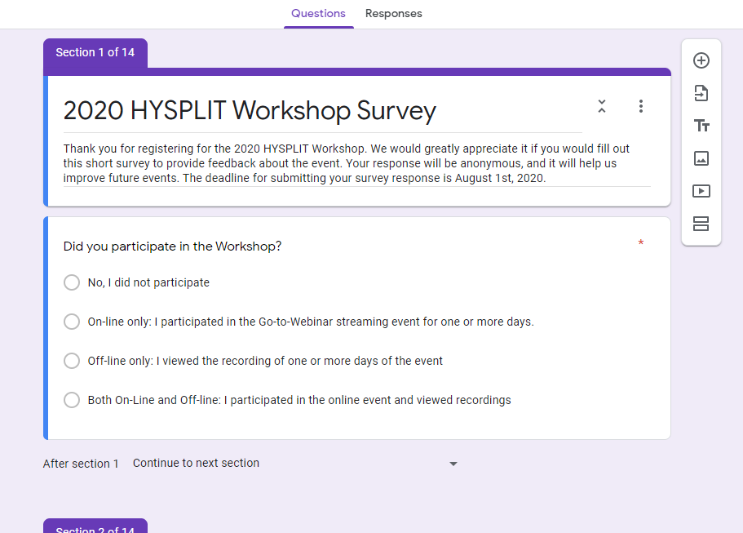
Course Survey
We will be sending out a course survey soon, and we hope you will return it
It can be anonymous, or you can provide your name – it is up to you
We will really appreciate hearing your feedback, about what went well and what we can try to improve.
2022
2021
2021

Slide 17
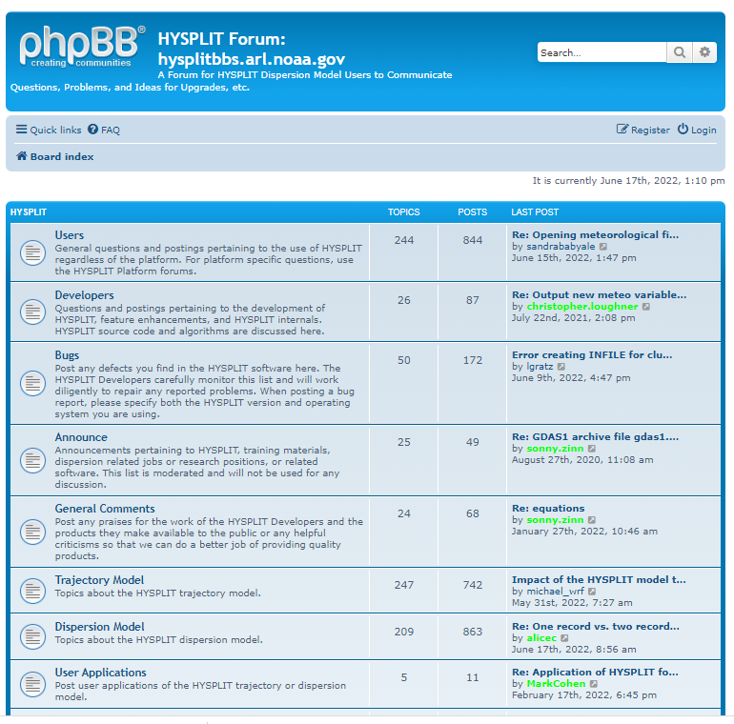
HYSPLIT Forum
https://hysplitbbs.arl.noaa.gov/index.php
Please feel free to continue to ask any questions that you have in the HYSPLIT Forum.
You can ask them in the 2022 Workshop section of the Forum, or you can ask them in another section of the Forum if it seems more relevant.
Wherever you ask the question, we will try to answer it.

Slide 18
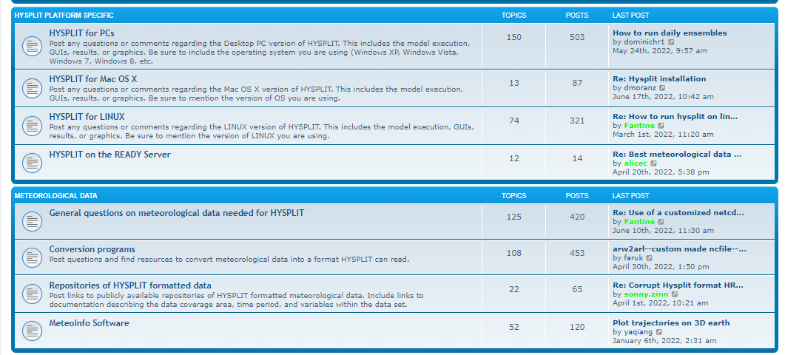
HYSPLIT Forum
https://hysplitbbs.arl.noaa.gov/index.php

Slide 19
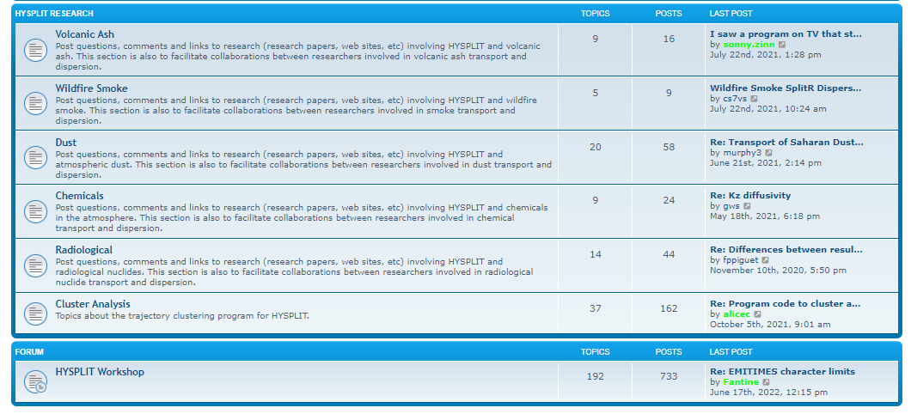
HYSPLIT Forum
https://hysplitbbs.arl.noaa.gov/index.php

Slide 20
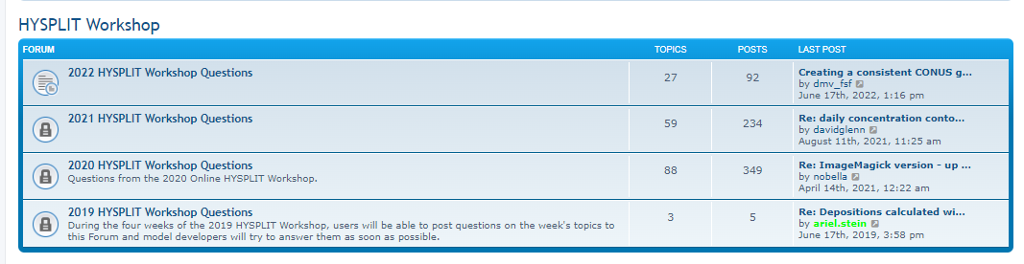
HYSPLIT Forum
https://hysplitbbs.arl.noaa.gov/index.php

Slide 21
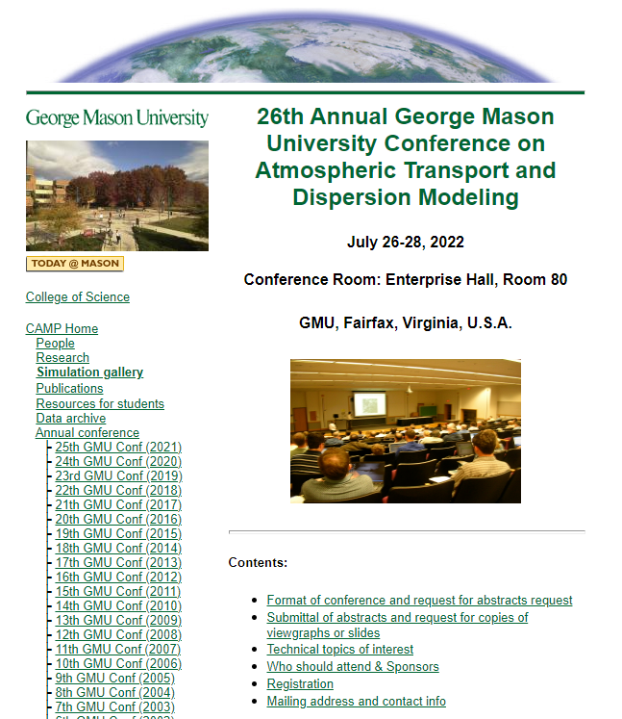
http://camp.cos.gmu.edu/26th-announcement.html
The 26th Annual George Mason University Conference on Atmospheric Transport and Dispersion Modeling will be held on July 26-28, 2022.
The deadline for submitting abstracts is July 16, 2022. Please send your abstracts to Joe Chang (gmu.atd.conference@gmail.com) and Zafer Boybeyi (zboybeyi@gmu.edu).
If there are enough HYSPLIT-related abstracts submitted, there will be special section on HYSPLIT applications

Slide 22
Thanks for your participation and for your interest in HYSPLIT!

