Slide 1
2022 Online HYSPLIT Workshop
(DAY 3 of 4) Wrap-Up
Workshop Web Page:
https://www.ready.noaa.gov/register/HYSPLIT_hyagenda.php
NOAA Air Resources Laboratory
June 14-17, 2022
Notes:
Hello, and welcome the 2020 HYSPLIT Workshop, being held entirely online this year. Some of you are watching live, and we hope that you have been able to join the event, and can hear us and can see what we are presenting. And some of you are watching a recording of the event, and we hope that your access to the recording is good. You are all in listen-only mode, and while you can see us, we cannot see you. To start us off, Dr. Ariel Stein, the Deputy Director of the NOAA Air Resources Laboratory, would like to welcome you.

Slide 2
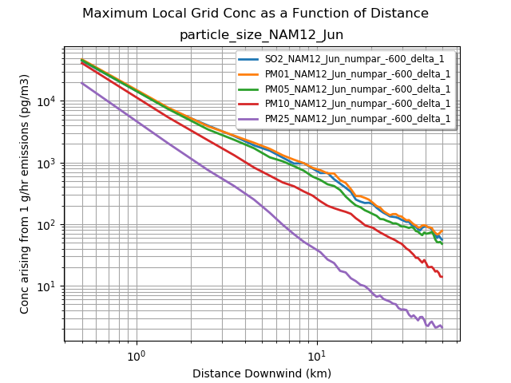
Not a very dramatic difference between gas-phase SO₂, and 1 and 5 µm particles
If pollutant partitions to atmospheric particles, most would be associated with particles less than 5 µm
Bigger differences seen with 10 and 25 µm particles

Slide 3
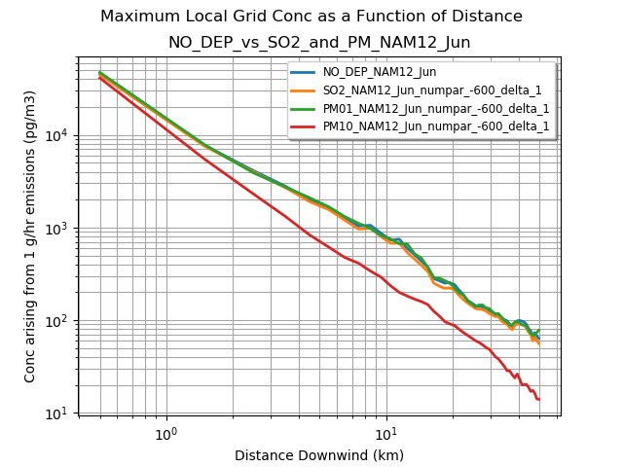
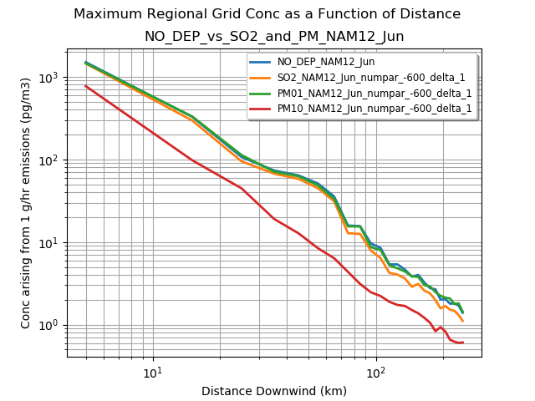
Compare simulation with no deposition with simulation of SO2, PM01 and PM10 with default deposition parameters
For maximum concentrations, little difference except for large particles (10 µm)

Slide 4
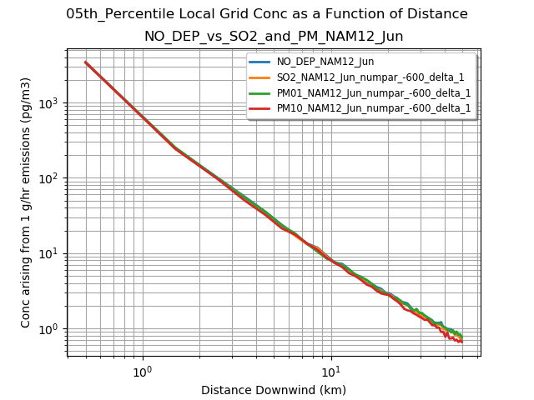
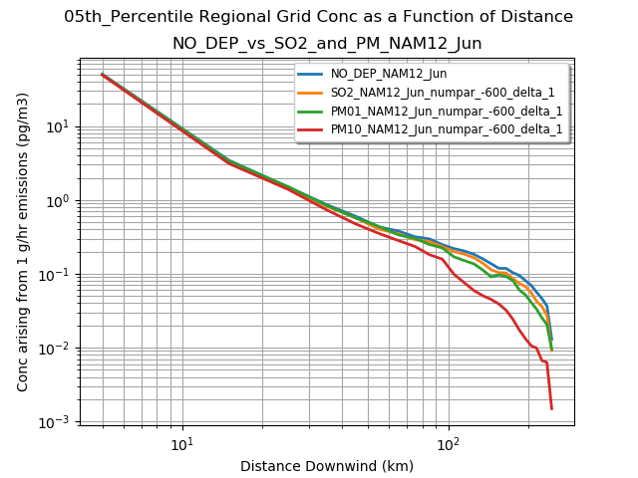
Compare simulation with no deposition with simulation of SO2, PM01 and PM10 with default deposition parameters
For 5th percentile, where one might expect to see the consequences of deposition (e.g., when it is raining), little difference except for large distances with large particles (10 µm)

Slide 5
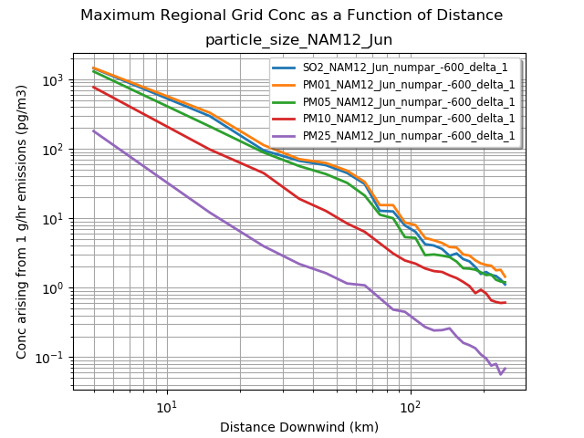
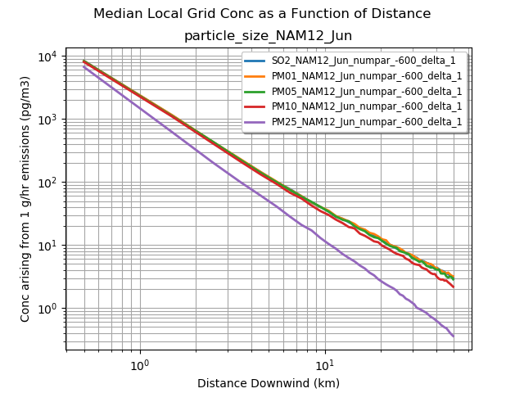
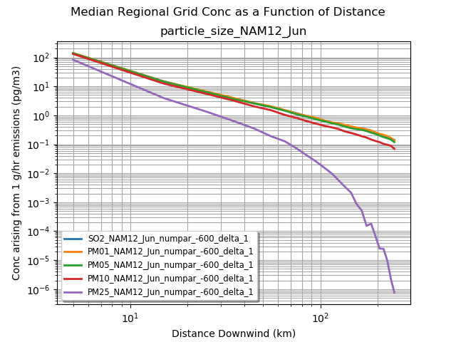
Not a very dramatic difference between gas-phase SO₂, and 1 and 5 µm particles
If pollutant partitions to atmospheric particles, most would be associated with particles less than 5 µm
Bigger differences seen with 10 and 25 µm particles

Slide 6
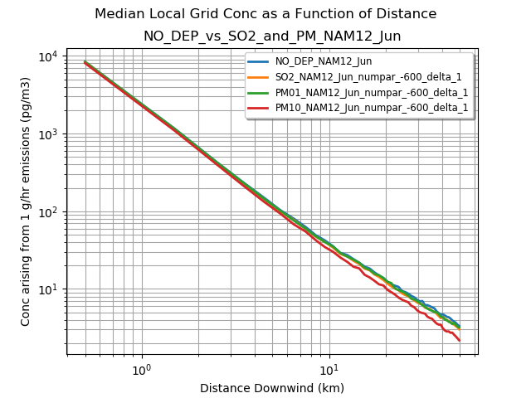
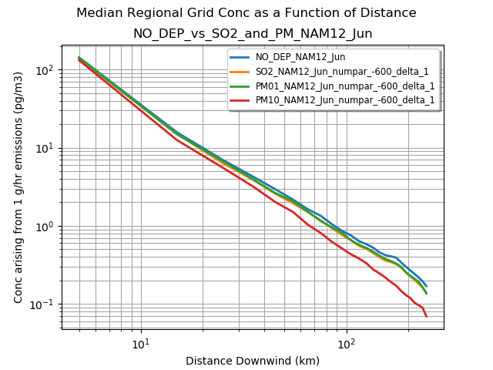
Compare simulation with no deposition with simulation of SO2, PM01 and PM10 with default deposition parameters
For median concentrations, little difference except for large particles (10 µm)

Slide 7
Example of overall impact of wet/dry deposition (for SO₂)
Without wet or dry deposition
With wet and dry deposition

Slide 8
Workshop guidance
and resources posted at
Workshop Web Page
https://www.ready.noaa.gov/
register/HYSPLIT_hyagenda.php
We will update this page each day to include any new materials or links that are relevant to the Workshop

Slide 9
Quick Recap of Logistics
General questions:
use Go-to-Webinar Question box and we will do our best to answer
We are not using the “raise hand” feature for questions
Detailed questions, e.g., about the model:
use the HYSPLIT Forum
if haven’t already, “register” in upper right corner of Forum web page
Handouts:
Other documents – e.g., this presentation – provided as Handouts in Go-to-Webinar and also on the Workshop Web Page
Recordings:
Each day’s recording will be posted to the Workshop Web Page as soon as it is ready, generally 4-8 hours after the day’s session ends.
If not installed, or if get too far behind:
Perfectly ok to view one or more sessions as “demonstrations” and then go back and do the sessions on your own. The Tutorial is designed to be done on one’s own in self-paced environment.

Slide 10
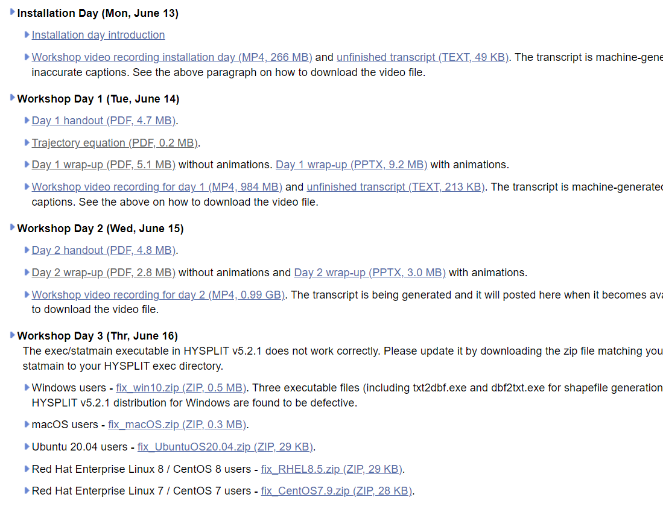
https://www.ready.noaa.gov/register/HYSPLIT_hyagenda.php

Slide 11
2022 HYSPLIT Workshop Schedule
Subject to change, depending on the progression of the course and at the discretion of the instructors
UTC | Eastern Daylight Time | Monday June 13, 2022 | Tuesday June 14, 2022 | Wednesday June 15, 2022 | Thursday June 16, 2021 | Friday June 17, 2021
13:00 - 14:00 | 9:00 - 10:00 | OPTIONAL* 1a. Installing HYSPLIT on Windows PC | Introduction | Introduction | Introduction | Introduction
 |  |  |  | 7. Air Concentration calculations | 11. Pollutant transformations and deposition | 15. Radioactive pollutants and dose
 |  |  | 3. Gridded Meteorological Data Files
 |  | Break
14:00 - 15:00 | 10:00 - 11:00 | OPTIONAL* 1b. Installing HYSPLIT on MAC
 |  |  | Break |  | Break
 |  | Break | 4. Trajectory Calculations |  | 12. Air Concentration Uncertainty
 |  |  |  | Break |  | Break
15:00 - 16:00 | 11:00 - 12:00 | One-on-one virtual installation sessions, by appointment |  | 8. Configuring the CAPTEX simulation |  | 16. Volcanic eruptions with gravitational settling
16:00 - 17:00 | 12:00 - 13:00 | One-on-one virtual installation sessions, by appointment | Break |  | Break
 |  |  |  | Break |  | Break
17:00 - 18:00 | 13:00 - 14:00 | One-on-one virtual installation sessions, by appointment | 5. Trajectory Options |  | 13. Source Attribution Methods
 |  |  |  | 9. Air concentration parameter sensitivity |  | 17. Custom Simulations
18:00 - 19:00 | 14:00 - 15:00 | One-on-one virtual installation sessions, by appointment
 |  |  | Break
 |  |  | 6. Trajectory Statistics |  |  | Break
 |  |  |  |  | Break | Final Questions and Course Wrap-Up
19:00 - 20:00 | 15:00 - 16:00 | One-on-one virtual installation sessions, by appointment |  | Break | 14a. Wildfire Smoke
 |  |  |  | 10. Alternate display options
 |  |  | Day 1 Wrap-Up |  | 14b. Dust Storms
20:00 - 21:00 | 16:00 - 17:00 | One-on-one virtual installation sessions, by appointment |  | Day 2 Wrap Up
 |  |  |  |  | Day 3 Wrap Up
 |  |  |  | Day 2 Wrap Up
Notes:
* The pre-Workshop installation sessions on Monday June 13, 2022 from 9 - 9:45 AM (EDT) for Windows PC and from 10 - 10:30 AM EDT for MAC are optional. We recommend all participants attempt to install the HYSPLIT model and associated software before the Workshop starts, according to instructions posted here. This may require assistance from your local IT support.

Slide 12
Agenda – Day 3
UTC | EDT | Agenda Item
13:00 – 13:15 | 09:00 – 09:15 | Introduction to Day 3
13:15 – 14:15 | 09:15 – 10:15 | 11. Pollutant Transformations and deposition
14:15 – 14:30 | 10:15 – 10:30 | Break
14:30 – 16:00 | 10:30 – 12:00 | 12. Air Concentration Uncertainty
16:00 – 17:00 | 12:00 – 13:00 | Break
17:00 – 18:45 | 13:00 – 14:45 | 13. Source Attribution Methods
18:45 – 19:00 | 14:45 – 15:00 | Break
19:00 – 19:45 | 15:00 – 15:45 | 14a. Wildfire Smoke
19:45 – 20:30 | 15:45 – 16:30 | 14b. Dust Storms
20:30 – 20:45 | 16:30 – 16:45 | Day 3 Wrap-up / questions
Note: all times are approximate

Slide 13
Agenda – Day 4
UTC | EDT | Agenda Item
13:00 – 13:15 | 09:00 – 09:15 | Introduction to Day 4
13:15 – 14:45 | 09:15 – 10:45 | 15. Radioactive Pollutants and Dose
14:45 – 15:00 | 10:45 – 11:00 | Break
15:00 – 16:30 | 11:00 – 12:30 | 16. Volcanic Eruptions with Gravitational Settling
16:30 – 17:30 | 12:30 – 13:30 | Break
17:30 – 18:30 | 13:30 – 14:30 | 17. Custom Simulations
18:30 – 18:45 | 14:30 – 14:45 | Break
18:45 – 19:45 | 14:45 – 15:45 | Question and answer session with course instructors
19:45 – 20:00 | 15:45 – 16:00 | Final course wrap-up
Note: all times are approximate

