Slide 1

2022 Online
HYSPLIT Workshop
(Wrap-up: DAY 2 of 4)
NOAA Air Resources Laboratory
June 14-17, 2022
Notes:
Hello, and welcome the 2020 HYSPLIT Workshop, being held entirely online this year. Some of you are watching live, and we hope that you have been able to join the event, and can hear us and can see what we are presenting. And some of you are watching a recording of the event, and we hope that your access to the recording is good. You are all in listen-only mode, and while you can see us, we cannot see you. To start us off, Dr. Ariel Stein, the Deputy Director of the NOAA Air Resources Laboratory, would like to welcome you.

Slide 2
Workshop guidance
and resources posted at
Workshop Web Page
https://www.ready.noaa.gov/
register/HYSPLIT_hyagenda.php
We will update this page each day to include any new materials or links that are relevant to the Workshop

Slide 3
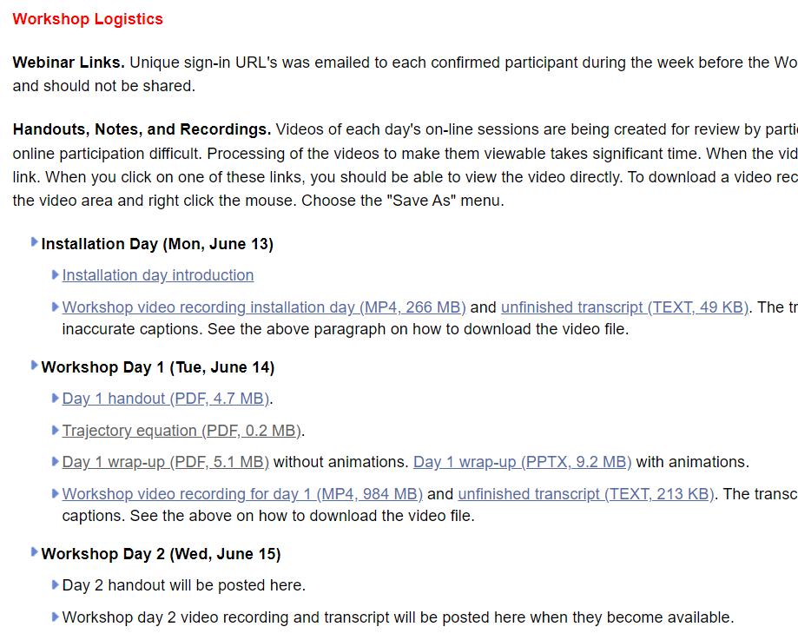
https://www.ready.noaa.gov/register/HYSPLIT_hyagenda.php

Slide 4
2022 HYSPLIT Workshop Schedule
Subject to change, depending on the progression of the course and at the discretion of the instructors
UTC | Eastern Daylight Time | Monday June 13, 2022 | Tuesday June 14, 2022 | Wednesday June 15, 2022 | Thursday June 16, 2021 | Friday June 17, 2021
13:00 - 14:00 | 9:00 - 10:00 | OPTIONAL* 1a. Installing HYSPLIT on Windows PC | Introduction | Introduction | Introduction | Introduction
 |  |  |  | 7. Air Concentration calculations | 11. Pollutant transformations and deposition (continued) | 15. Radioactive pollutants and dose
 |  |  | 3. Gridded Meteorological Data Files
 |  | Break
14:00 - 15:00 | 10:00 - 11:00 | OPTIONAL* 1b. Installing HYSPLIT on MAC
 |  |  | Break |  | Break
 |  | Break | 4. Trajectory Calculations |  | 12. Air Concentration Uncertainty
 |  |  |  | Break |  | Break
15:00 - 16:00 | 11:00 - 12:00 | One-on-one virtual installation sessions, by appointment |  | 8. Configuring the CAPTEX simulation |  | 16. Volcanic eruptions with gravitational settling
16:00 - 17:00 | 12:00 - 13:00 | One-on-one virtual installation sessions, by appointment | Break |  | Break
 |  |  |  | Break |  | Break
17:00 - 18:00 | 13:00 - 14:00 | One-on-one virtual installation sessions, by appointment | 5. Trajectory Options |  | 13. Source Attribution Methods
 |  |  |  | 9. Air concentration parameter sensitivity |  | 17. Custom Simulations
18:00 - 19:00 | 14:00 - 15:00 | One-on-one virtual installation sessions, by appointment
 |  |  | Break
 |  |  | 6. Trajectory Statistics |  |  | Break
 |  |  |  |  | Break | Final Questions and Course Wrap-Up
19:00 - 20:00 | 15:00 - 16:00 | One-on-one virtual installation sessions, by appointment |  | Break | 14a. Wildfire Smoke
 |  |  |  | 10. Alternate display options
 |  |  | Day 1 Wrap-Up |  | 14b. Dust Storms
20:00 - 21:00 | 16:00 - 17:00 | One-on-one virtual installation sessions, by appointment |  | 11. Pollutant transformations and deposition
 |  |  |  |  | Day 3 Wrap Up
 |  |  |  | Day 2 Wrap Up
Notes:
* The pre-Workshop installation sessions on Monday June 13, 2022 from 9 - 9:45 AM (EDT) for Windows PC and from 10 - 10:30 AM EDT for MAC are optional. We recommend all participants attempt to install the HYSPLIT model and associated software before the Workshop starts, according to instructions posted here. This may require assistance from your local IT support.

Slide 5
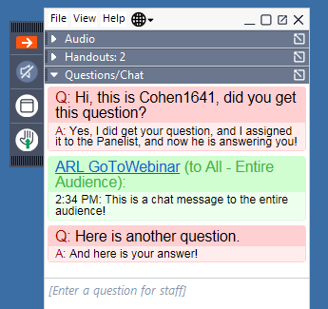
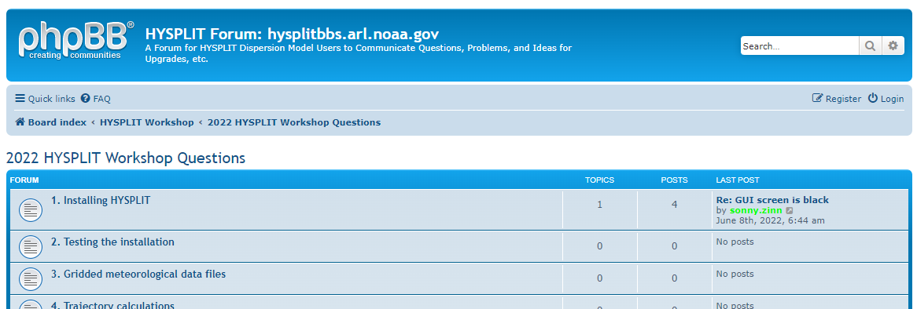
Asking Questions
Ask general or logistical questions about the Webinar or Go-to-Webinar in the Control Panel that was just discussed
...if viewing a recording, can ask general questions by emailing arl.webmaster@noaa.gov
Ask questions about HYSPLIT and the Tutorial in the HYSPLIT Forum
https://hysplitbbs.arl.noaa.gov/viewforum.php?f=76

Slide 6
Quick Recap of Logistics
General questions:
    use Go-to-Webinar Question box and we will do our best to answer
    We are not using the “raise hand” feature for questions
Detailed questions, e.g., about the model:
    use the HYSPLIT Forum
    if haven’t already, “register” in upper right corner of Forum web page
Handouts:
    Other documents – e.g., this presentation – provided as Handouts in Go-to-Webinar and also on the Workshop Web Page
Recordings:
    Each day’s recording will be posted to the Workshop Web Page as soon as it is ready, generally 4-8 hours after the day’s session ends.
If not installed, or if get too far behind:
    Perfectly ok to view one or more sessions as “demonstrations” and then go back and do the sessions on your own. The Tutorial is designed to be done on one’s own in self-paced environment.

Slide 7
Trajectory ~ Center Line of Plume
With a real-world pollution release, there is always an expanding plume as the pollutants travel downwind
The trajectory of a single computational point particle released from the source and simulated with the HYSPLIT Trajectory model is the center line of a plume of pollutants emitted from a source
z
x
+ y
- y
Notes:
https://www.translationdirectory.com/glossaries/glossary249.php

Slide 8
Atmospheric Turbulence → particles don’t follow simple paths, but follow “turbulent trajectories”
z
To simulate this dispersion, the HYSPLIT concentration model adds in an additional turbulent motion of the computational point particles as they are blown downwind.
x
+ y
- y
Notes:
https://www.translationdirectory.com/glossaries/glossary249.php

Slide 9
Plume simulation = A collection of turbulent particle trajectories
To simulate a plume from a source, we release many particles at a time, and this cloud of particles is transported downwind
Each computational point particle gets additional motion based on the amount of turbulence in the atmosphere.
Here we are showing just 6 particles released at one time. In a real HYSPLIT run, you would release 100’s or 1000’s or even more particles at any given time.
z
x
+ y
If the pollutant release was ongoing, you would keep releasing particles from the source as long as you wanted to simulate the emissions.
As the wind changes speed and direction, and as the turbulence in the atmosphere changes, the plume will be dispersed in different directions and will be dispersed to different extents.
- y
Notes:
https://www.translationdirectory.com/glossaries/glossary249.php

Slide 10
What do HYSPLIT Computational Point Particles actually represent?
A small parcel of air that contain one or more pollutants
Each Computational Point Particle (parcel) contains a vast multitude of actual pollutant entities
  molecules (in gas phase)
  and/or atmospheric pollutant particles
Amount of actual pollutant associated with a Computational Point Particle is determined by the emissions rate divided by the number of Computational Point Particles released in the simulation. Both of these parameters are set by the user.
Example: NO₂ emissions from a power plant.
  Suppose there is a power plant that emits 1000 pounds of NO₂ per hour
  Suppose we do a simulation that releases 500 Computational Point Particles per hour
  You can calculate that there are 1.2 x 10²⁵ NO₂ molecules per HYSPLIT Computational Point Particle
  With the same emission rate, if you release 5000 Computational Point Particles per hour, there will 10x less NO₂ molecules per particle, e.g., 1.2 x 10²⁴

Slide 11
Details of Calculation for NO₂ Emissions Example:
pounds NO₂
-----------------
hour
1
-----
500
hour
------------------------
HYSPLIT particles
grams NO₂
-----------------
pound NO₂
1000
*
*
454
1
------
46
mole NO₂
-------------------
grams NO₂
molecules NO₂
-----------------
mole NO₂
molecules NO₂
-------------------
HYSPLIT particle
*
*
6.022 x 10²³
= 1.2 x 10²⁵

Slide 12
What do HYSPLIT Computational Point Particles actually represent?
A small parcel of air that contain one or more pollutants
Each Computational Point Particle (parcel) contains a vast multitude of actual pollutant entities
  molecules (in gas phase)
  and/or atmospheric pollutant particles
Amount of actual pollutant associated with a Computational Point Particle is determined by the emissions rate divided by the number of Computational Point Particles released in the simulation. Both of these parameters are set by the user.
Example: particulate emissions from a fire.
  Suppose there is a fire that is emitting 1000 pounds per hour of particulate (smoke), that the average particle size is 5 µm diameter, and the average particle density is 1 g/cm³
  Suppose we do a simulation that releases 500 computational point particles per hour
  You can calculate that there are 1.4 x 10¹³ smoke particles per HYSPLIT computational point particle

Slide 13
Details of Calculation for Smoke Emissions Example:
pounds smoke
-----------------
hour
grams smoke
-----------------
pound smoke
m³
------
cm³
1000
*
454
*
1.0 x 10⁻⁶
smoke particles
-------------------
HYSPLIT particle
= 1.4 x 10¹³
4
---
3
3
HYSPLIT particles
------------------------
hour
π
2.5 x 10⁻⁶ meters
gram smoke
-----------------
cm³ smoke
500
*
*
1
----------------------------------------
smoke particle

Slide 14
Concentration Simulations require Concentration Output Grid(s)
(Conc grids are completely distinct from and independent of met data grid(s))
In a HYSPLIT Concentration simulation, you define one or more concentration grids, where you specify the horizontal and vertical grid spacing, the overall extent, and the time resolution.
During the HYSPLIT simulation, the model outputs concentration results for each grid you have defined.
These grids do not affect the simulation, they just affect what sort of output you get.
z
x
+ y
The concentration in each grid cell – over the user-specified averaging time -- is calculated as:
[the number of particles in the grid cell] * [the mass of pollutant on each particle ] / [volume of the grid cell]
- y

Slide 15
Can have more than one concentration grid
You can define more than one grid, each with its own specifications.
Depending on where the grid is and which way the wind is blowing during the simulation, you might not get any computational point particles in the grid, and all concentrations in the grid will be zero.
If a grid has very fine spacing, you might need to increase the number of computational point particles released in the simulation.
The particles are “discrete” and if there are too few of them, you aren’t really representing the continuous plume, and you can get very blotchy results.
z
grid #1
grid #2
x
+ y
- y

Slide 16
Agenda – Day 3
UTC | EDT | Agenda Item
13:00 – 13:15 | 09:00 – 09:15 | Introduction to Day 3
13:15 – 14:15 | 09:15 – 10:15 | 11. Pollutant Transformations and deposition (start today or continue from yesterday)
14:15 – 14:30 | 10:15 – 10:30 | Break
14:30 – 16:00 | 10:30 – 12:00 | 12. Air Concentration Uncertainty
16:00 – 17:00 | 12:00 – 13:00 | Break
17:00 – 18:45 | 13:00 – 14:45 | 13. Source Attribution Methods
18:45 – 19:00 | 14:45 – 15:00 | Break
19:00 – 19:45 | 15:00 – 15:45 | 14a. Wildfire Smoke
19:45 – 20:30 | 15:45 – 16:30 | 14b. Dust Storms
20:30 – 20:45 | 16:30 – 16:45 | Day 3 Wrap-up / questions
Note: all times are approximate

Slide 17
Extra Slides

Slide 18
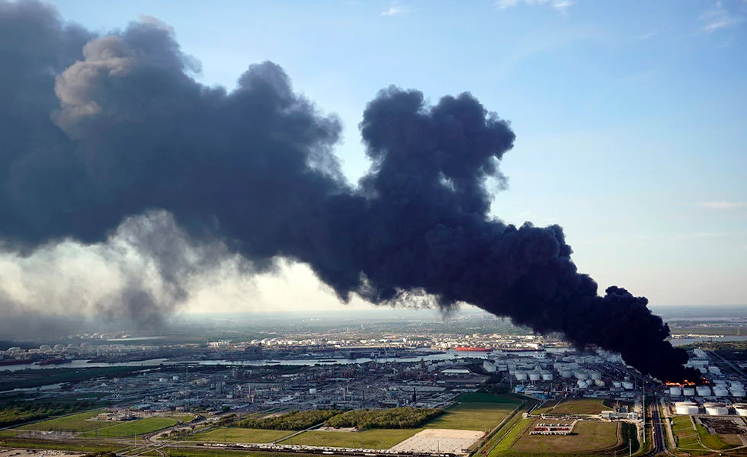
HYSPLIT
An atmospheric transport and dispersion model
Continuous development at the NOAA Air Resources Laboratory since 1949
Uses meteorological data and emissions data as inputs
Estimates what happens when pollutants are emitted into the air
The model has been tested extensively by comparison of its predictions against actual measurements of atmospheric concentrations and deposition.
HYSPLIT is one of the most widely used atmospheric transport and dispersion models in the world.
A plume of air pollutants emitted from an industrial fire in Deer Park, Texas, March 2019. AP Photo: David J. Philip
Notes:
https://www.texasobserver.org/air-pollution-coronavirus-houston-epa/
A plume of smoke rises from a petrochemical fire at the Intercontinental Terminals Company in Deer Park in March 2019—four months after an explosion and fire at the Houston-area petrochemical site. AP PHOTO/DAVID J. PHILLIP
https://images.app.goo.gl/xkiPR2MwTBXboMGu8

Slide 19
What is HYSPLIT Used For?
Emergency Response (within NOAA, other Fed, State, Local agencies, domestic and international)
  Nuclear Accidents
  Volcanic Eruptions (e.g., aviation impacts)
  Wildfires
  Industrial / Transportation Accidents releasing toxic chemicals
  Insect dispersal (e.g., locusts)
Source-attribution
  Back-tracking from air pollution measurements
    Genesis of ARL was to back-track from airborne radionuclide measurements to find site of Russian nuclear test site in 1949
    Current support for Comprehensive Test Ban Treaty Organization
Planning, scenario investigations

Slide 20
What is HYSPLIT Not Used For?
Complex, non-linear atmospheric chemistry situations
  E.g., atmospheric photochemistry (ozone, etc) where emissions from all sources must be modeled at the same time. For this type of atmospheric modeling situation, you would use a gridded Eulerian model like the Community Multiscale Air Quality (CMAQ) model.
  HYSPLIT is a Lagrangian model – it follows plumes.
    This makes it much, much faster than an Eulerian model like CMAQ
    So, it can be used for Emergency Response
  You can do more than one plume, but if there are chemical reactions between polllutants in one plume and another plume, HYSPLIT is not well suited to simulate that.
  HYSPLIT has actually been applied to atmospheric photochemistry and related situations, and in these cases, the model has been expanded to incorporate an Eulerian (gridded) modeling approach. But these are not common applications of the model.

Slide 21
Different Ways to Use HYSPLIT
Online - READY Website (https://www.ready.noaa.gov/index.php)
  Secure applications for national security issues
  Specialized applications for different needs
  Researcher access
  Public access
Download model (free) and run on your local computer
  GUI = Graphical User Interface
  Command Line / Scripts
  Download met data to run HYSPLIT from ARL website

Slide 22
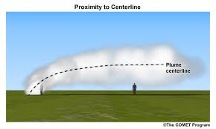
Two different kinds of HYSPLIT simulations
Trajectory
  Center-line of a plume -- an oversimplification, but can provide very useful information
  Can go forward or backward
  Does not factor in any deposition or chemistry
Concentration - Dispersion
  The full 3D transport and dispersion of a plume
  Includes transport by wind, but also dispersion around center line
  Gives air concentrations downwind -- (e.g., can compare with public health thresholds)
  Can include chemistry and wet and dry atmospheric deposition

Slide 23
At its core, the HYSPLIT model just transports “particles” as they are blown along by the wind
z
wind speed and direction at position 3
wind speed and direction at position 2
wind speed and direction at position 1
x
+ y
particle movement in time step 2
particle movement in time step 1
- y

Slide 24
Met Data Required!
Meteorological Data Grid(s) - Required
These are the outputs from a meteorological model
  e.g. a weather forecasting model
  wind speed & direction and other met data on a 3-D grid
Data sets differ based on
  What model was used to generate them
  The horizontal grid spacing
  The vertical grid spacing
  The temporal resolution (e.g., data every hour)
HYSPLIT must have these data to run
  Data must be in “HYSPLIT format” (binary, ...)
  ARL provides datasets for download (most from NOAA weather models)
  HYSPLIT needs the filename and location on your computer
  File must include the area and times that you are doing your run in
    If a particle goes off the met data grid, it is terminated
    If there are missing times, the model “crashes”
  Can have multiple met files (e.g., several 1-day files for a multi-day simulation)
Uncertainties
  Weather model uncertainties (e.g., wind direction and speed not exactly right)
  HYSPLIT interpolates between grid points (in space and time) to estimate the wind speed and direction at the actual location of a particle
z
x
+ y
- y

Slide 25
Selected Meteorological Datasets Available from NOAA ARL Archives* (~100 TB)
(https://ready.arl.noaa.gov/archives.php)
 | Dataset | Horizontal Resolution (km- approx.) | Full-grid dimensions | Temporal resolution (hrs) | Vertical Levels | Period of each file | Size of each file (GB) | Total size for one month of data (GB) | Availability
Continental U.S. and surrounding regions | HRRR-3km | 3 | 1799 x 1059 | 1 | 37 | ¼ day | 3.2 | 390 | Jun 2015 -> present
 | NAMS-12km Hybrid | CONUS - 12 Alaska - 12 Hawaii – 2 |  | 1 | 40 | 1 day | 1.0 0.64 0.71 | 30 19 21 | 2010 -> present
 | NAM-12km | 12 | 614 x 428 | 3 | 27 | 1 day | 0.395 | 12 | May 2007 -> present
 | WRF-ARW-27km | 27 | 216 x 174 | 1 | 35 | 1 day | 0.210 | 6.4 | 1980 -> present
 | NARR-32km | 32 | 309 x 237 | 3 | 24 | 1 month | 2.8 | 2.8 | 1979 -> 2019
 | EDAS-40km | 40 | 185 x 129 | 3 | 27 | ½ month | 0.6 | 1.2 | 2004 -> 2018
Global | GFS - 0.25º | 27 | 1440 x 721 | 3 | 56 | 1 day | 2.7 | 82 | Jun 2019 -> present
 | GDAS - 0.5º | 55 | 720 x 361 | 3 | 56 | 1 day | 0.468 | 14 | Sep 2007 -> Jun 2019
 | GDAS - 1º | 111 | 360 x 181 | 3 | 24 | 1 week | 0.571 | 2.5 | Dec 2004 -> present
 | Global Reanalysis - 2.5º | 278 | 144 x 73 | 6 | 18 | 1 month | 0.11 | 0.11 | 1948 -> present

Slide 26
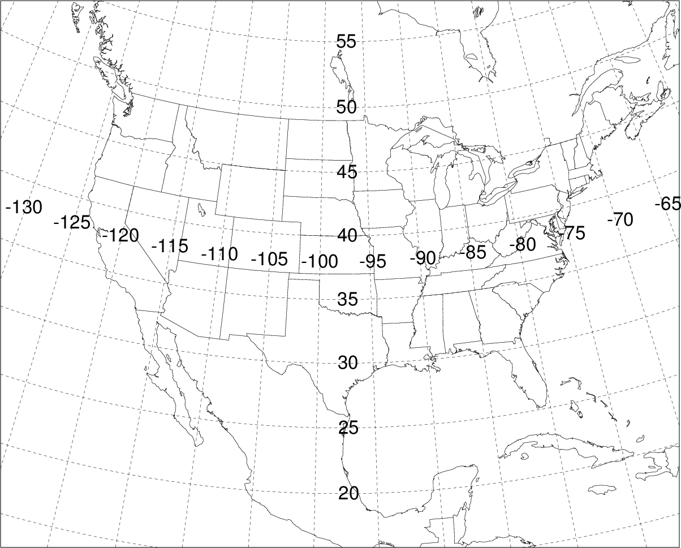
Domain of WRF-ARW-27km met data set
Horizontal spacing ~27 km
35 vertical levels
Data every hour
Each file is for one day
(~210 MB per file)
174 grid points
216 grid points

Slide 27
Trajectory
The simulated movement in the atmosphere of one “computational particle” is called a Trajectory
  3-dimensional movement (x, y, and z)
  If you started the trajectory at different times, it would go in different directions, depending on which way the wind was blowing
  think of this as the center line of a plume of pollutants emitted from a source
z
x
+ y
- y
Notes:
https://www.translationdirectory.com/glossaries/glossary249.php

Slide 28

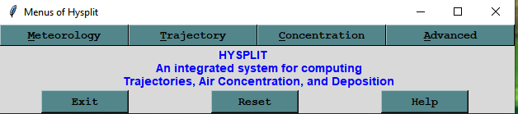
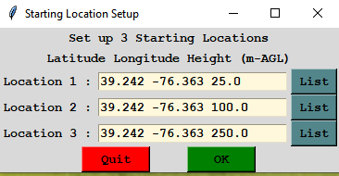
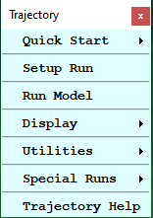
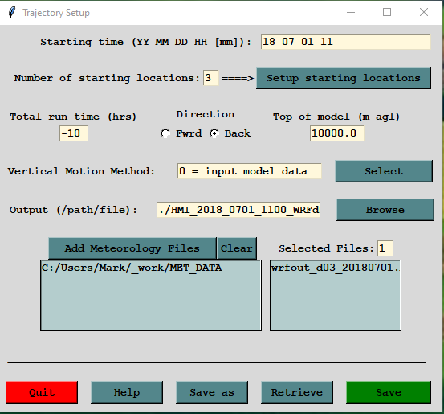
HYSPLIT Graphical User Interface setup for Trajectory Simulation
When you hit “save”, the Graphical User Interface writes a CONTROL file to the hysplit\working directory

Slide 29
CONTROL file entry | Meaning | Notes / Comments
04 05 01 00 00 | Start date / time for simulation (YR MO DA HR MN) | All times in HYSPLIT are Universal Coordinated Time (UTC) (a.k.a. Greenwich Mean Time) e.g. Eastern Daylight Time (EDT) = UTC – 4 hours e.g. 11 AM EDT = 3 PM UTC Minutes are optional Each entry must be 2-digits (e.g., 04 rather then 2004)
1 | Number of starting locations
40.0 -77.0 100.0 | Starting location: latitude, longitude, height [meters above ground level (m-agl)] | If there is more than 1 starting location or height, each must be on a separate line West Longitudes are negative
24 | duration of run (hours)
0 | vertical motion option (0 = just use the meteorological data)
10000 | top of model domain (meters) | generally 10000 or 25000
1 | number of met data files
C:\hysplit\metdata\ | directory of 1st met file (must contain trailing “\”) (“/” on MAC or LINUX) | If there is more than 1 met file being used, then these two lines will be repeated for each met file.
wrfout_d01_20040501.ARL | name of 1st met file

Slide 30
Example of simple CONTROL file for a trajectory model run
04 05 01 00 00
1
40.0 -77.0 100.0
24
0
10000
1
C:\hysplit\metdata\
wrfout_d01_20040501.ARL

Slide 31
CONTROL file
Required for HYSPLIT to run
Must be an ascii-text file
If you are having a problem with your run, look at the CONTROL file.
If you are trying to get someone to help you figure out what happened or what went wrong, you will need to send them the CONTROL file
HYSPLIT Trajectory Model (hyts_std.exe)
Is there a CONTROL file in the directory you are running the model from?
NO → model stops immediately
YES → model tries to read CONTROL file to get required run parameters
Is the CONTROL file properly constructed, e.g., all expected lines present in the correct order, etc?
NO → model stops with error message (...can be hard to understand)
YES → model starts to run
Can the model find the met data file(s) you specified in the CONTROL file?
NO → model stops with error message (cannot find file...)
YES → model continues
Does your starting location and time fit within the domain of the met data file?
NO → model stops with error message
YES → model starts to simulate the trajectory

Slide 32
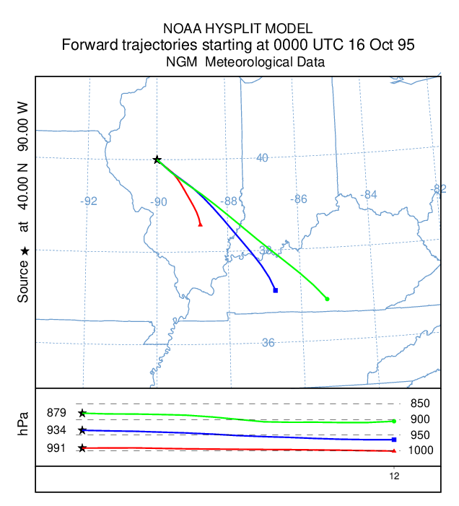
Workflow associated with a typical HYSPLIT Trajectory simulation
Command Line or Script
write CONTROL file
write SETUP.CFG file
hysplit\exec\hyts-std
hysplit\exec\trajplot
additional scripts
Advanced
→ Config. Setup
→ Trajectory
Trajectory
Display
Trajectory
GUI
Trajectory
→ Setup Run
Trajectory
→ Run Model
Advanced
→ View Messages
Trajectory
Special Runs
trajectory dump output file (tdump.txt)
Trajectory Plotting program (trajplot)
Additional post-processing programs, e.g. trajectory clustering, trajectory frequency
CONTROL file (required)
HYSPLIT Trajectory model
(hyts_std)
SETUP.CFG file (optional)
Met Data File(s)
MESSAGE file

Slide 33
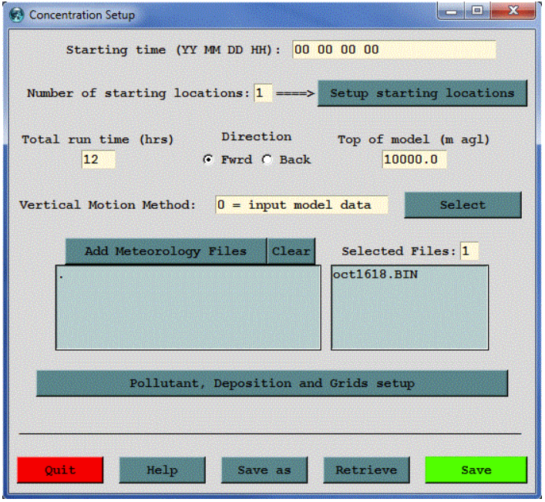
CONTROL file structure
1. Basic parameters (Trajectory or Concentration)
Start date / time for simulation (YR MO DA HR MN)
Number of starting locations
For each starting location: latitude, longitude, height
duration of run (hours)
vertical motion option (0=data)
top of model domain (m)
number of met data files
for each met file:
  directory for file
  name of file

Slide 34
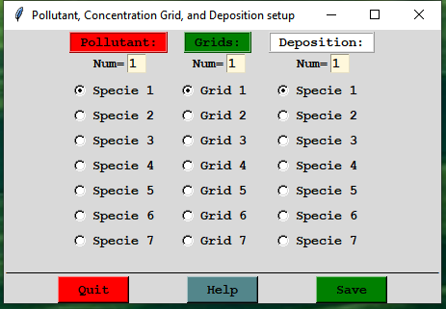
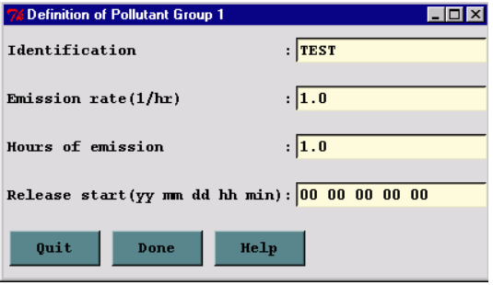
CONTROL file structure
2. Emission parameters
number of different pollutants
for each pollutant:
  pollutant 4-character identification name
  emissions rate (per hour)
  hours of emissions
  release start time

Slide 35
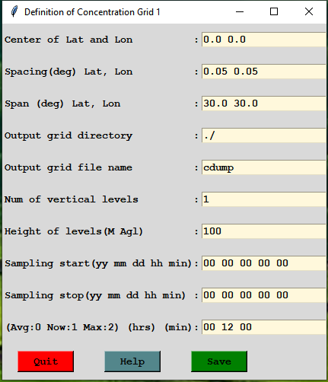
CONTROL file structure
3. Concentration Grids
Number of concentration grids
For each grid:
  center (Lat Long)
  grid spacing (degrees) (Lat Long)
  grid span (degrees) (Lat Long)
  directory for grid output file
  name of grid output file
  number of vertical levels
  height of level (m-agl)
  sampling start time
  sampling end time
  sampling interval
  (type, hour, minute)

Slide 36
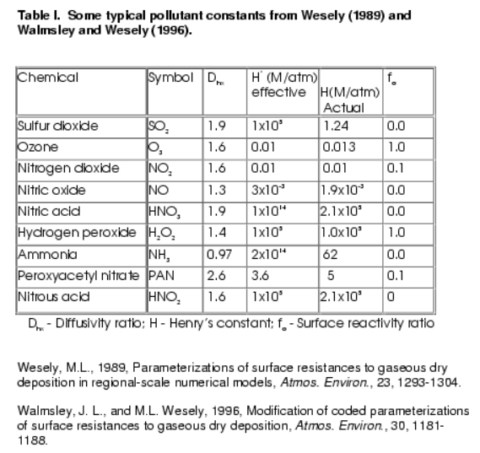
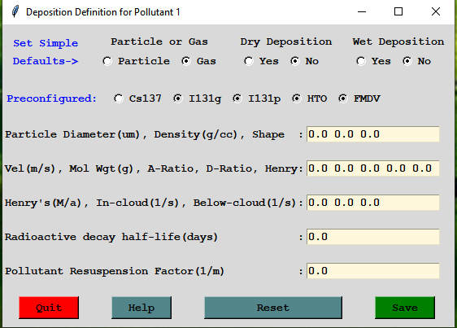
CONTROL file structure
4. Deposition parameters
number of pollutants depositing
for each depositing pollutant:
  particle diameter, density and shape
  Deposition velocity (m/s), Pollutant molecular weight (Gram/Mole), Surface Reactivity Ratio, Diffusivity Ratio, Effective Henry's Constant
  Wet Removal: Actual Henry's constant, In-cloud (GT 1 =L/L; LT 1 =1/s), Below-cloud (1/s)
  radioactive decay half-life (days)
  pollutant resuspension (1/m)

Slide 37
CONTROL file structure
2. Emission parameters
number of different pollutants
for each pollutant:
  pollutant 4-character identification name
  emissions rate (per hour)
  hours of emissions
  release start time
1. Basic parameters (Trajectory or Concentration)
Start date / time for simulation (YR MO DA HR MN)
Number of starting locations
For each starting location: latitude, longitude, height
duration of run (hours)
vertical motion option (0=data)
top of model domain (m)
number of met data files
for each met file:
  directory for file
  name of file
4. Deposition parameters
number of pollutants depositing
for each depositing pollutant:
  particle diameter, density and shape
  Deposition velocity (m/s), Pollutant molecular weight (Gram/Mole), Surface Reactivity Ratio, Diffusivity Ratio, Effective Henry's Constant
  Wet Removal: Actual Henry's constant, In-cloud (GT 1 =L/L; LT 1 =1/s), Below-cloud (1/s)
  radioactive decay half-life (days)
  pollutant resuspension (1/m)
3. Concentration Grids
Number of concentration grids
For each grid:
  center (Lat Long)
  grid spacing (degrees) (Lat Long)
  grid span (degrees) (Lat Long)
  directory for grid output file
  name of grid output file
  number of vertical levels
  height of level (m-agl)
  sampling start time
  sampling end time
  sampling interval
  (type, hour, minute)
Note that turning on deposition will result in the removal of mass and the corresponding reduction in air concentration, the deposition will not be available in any output unless height "0" is defined as one of the concentration grid levels.

Slide 38
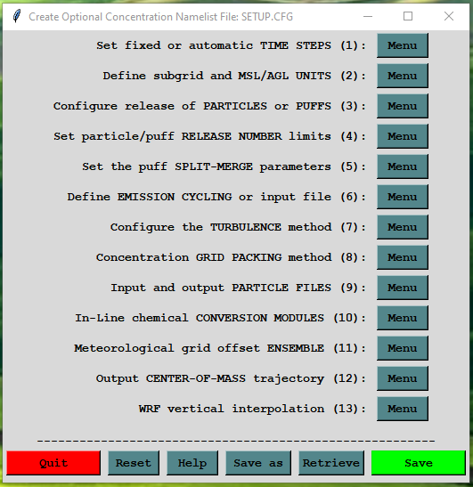
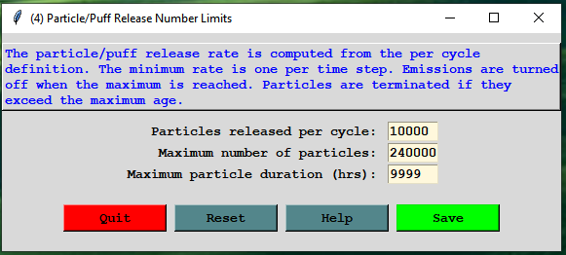
SETUP.CFG file structure
GUI: Advanced → Configuration Setup → Concentration
&SETUP
numpar = 10000,
maxpar = 240000,
/
Example
of simple SETUP.CFG file (optional)
maxpar must generally be greater than or equal to the run_duration * numpar
E.g., for a 24hr simulation, releasing 10,000 particles per hour, you need a maximum number of particles of 240,000

Slide 39
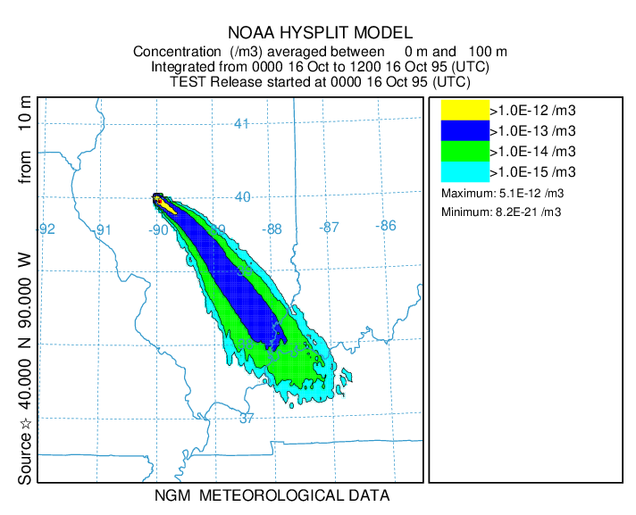
Workflow associated with a typical HYSPLIT Concentration simulation
Command Line or Script
write
CONTROL file
write SETUP.CFG file
hysplit\exec\hycs-std
hysplit\exec\concplot
hysplit\exec\con2asc
hysplit\exec\con2stn
Advanced
→ Config. Setup
→ Concentration
Concentration
Display
Contours
Concentration
Utilities
Convert to
Ascii (or Station)
GUI
Concentration
→ Setup Run
Concentration
→ Run Model
Advanced
→ View Messages
CONTROL file (required), ...including Pollutant, Deposition, and Grids Setup...
binary output file for each concentration grid defined
(cdump_1, cdump_2, cdump_3, ...)
Concentration Plotting program (concplot)
Additional post-processing programs, e.g.
con2asc
create ascii
text file with concentration values at each
grid point
con2stn
create ascii
text file with concentration values at a particular location
SETUP.CFG file (optional)
HYSPLIT Concentration model
(hycs_std.exe)
If a SETUP.CFG file is present, HYSPLIT will use it, even if its not how you wanted to do the run!
Met Data File(s)
MESSAGE file

Slide 40
HYSPLIT Tips and Tricks
CONTROL file: Look at this file if you are having a problem – sometimes you can see obvious errors
GUI: When you are using the GUI, most input and output files will be in hysplit\working\
Scripts: usually create a new working directory, e.g., hysplit\working_Workshop\
Met File(s): Correct directory and name; encompass time & spatial domain of your desired simulation
Ascii text: CONTROL, SETUP.CFG, MESSAGE, TDUMP files (trajectory output files), scripts
Binary: Met data files, CDUMP files (concentration output files)
Options: Not all available from GUI; can type executable name from command line to see options
Met data archives: https://www.ready.noaa.gov/archives.php
Many other HYSPLIT programs in the HYSPLIT exec directory (e.g., met data analysis programs); some are available in the GUI, but not all
Graphics: HYSPLIT has some graphical capabilities – including some new Python graphics – but you can also display your model outputs using other graphics platforms (Google Earth, GIS, python, Matlab...)
Numerical Experiments:
  Do you have enough particles in your simulation? Increase the number and see if your answers change. Keep increasing until the answers level off. The finer the grid you use, the more particles you need.
  Do the same simulation with different met data sets to evaluate sensitivity to met data uncertainties
  And you can do other sensitivity tests for other parameters

Slide 41
C:\Users\Mark\hysplit\working>..\exec\trajplot
USAGE: trajplot -[options (default)]
-a[GIS output: (0)-none 1-GENERATE_points 3-KML 4-partial_KML 5-GENERATE_lines]
-A[KML options: 0-none 1-no extra overlays 2-no endpoints 3-Both 1&2]
-e[End hour to plot: #, (all) ]
-f[Frames: (0)-all files on one 1-one per file]
-g[Circle overlay: ( )-auto, #circ(4), #circ:dist_km]
-h[Hold map at center lat-lon: (source point), lat:lon]
-i[Input files: name1+name2+... or +listfile or (tdump)]
-j[Map background file: (arlmap) or shapefiles.<(txt)|process suffix>]
-k[Kolor: 0-B&W, (1)-Color, N:colortraj1,...colortrajN]
1=red,2=blue,3=green,4=cyan,5=magenta,6=yellow,7=olive
-l[Label interval: ... -12, -6, 0, (6), 12, ... hrs
<0=with respect to traj start, >0=synoptic times)]
-L[LatLonLabels: none=0 auto=(1) set=2:value(tenths)]
-m[Map proj: (0)-Auto 1-Polar 2-Lambert 3-Merc 4-CylEqu]
-o[Output file name: (trajplot.ps)]
-p[Process file name suffix: (ps) or process ID]
-s[Symbol at trajectory origin: 0-no (1)-yes]
-v[Vertical: 0-pressure (1)-agl, 2-theta 3-meteo 4-none]
-z[Zoom factor: 0-least zoom, (50), 100-most zoom]
NOTE: leave no space between option and value
Not all program options available from GUI
More options from scripts
Type executable name from command line to see options
At left: trajplot (the program that plots trajectories)
EXAMPLE: trajplot –itdump.txt –oFIRE –a3 –A3

Slide 42
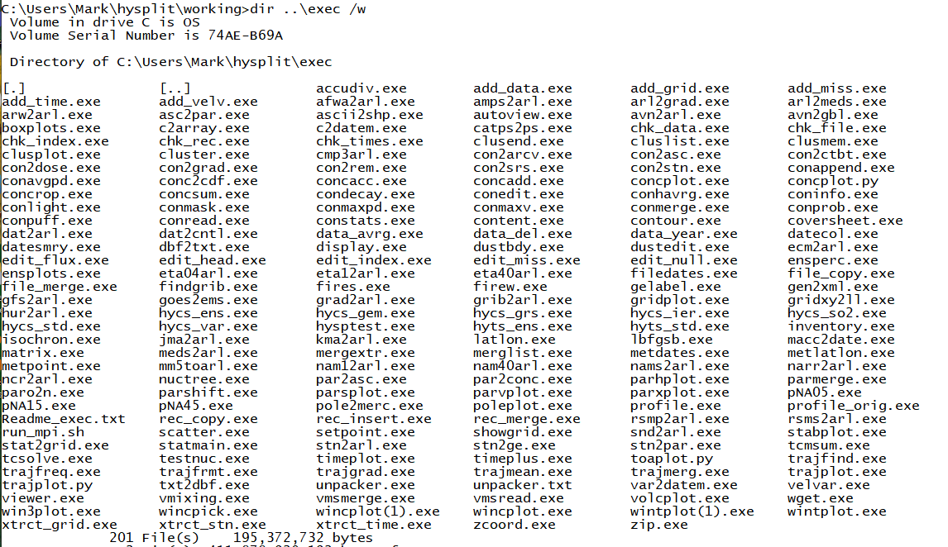
Many programs in the HYSPLIT exec directory (e.g., met data analysis programs); some in GUI, but not all
The programs underlined in red have been mentioned today

Slide 43
HYSPLIT Documentation and Learning Resources
HYSPLIT Tutorial: detailed instructions on using the GUI + example scripts; can be run online or downloaded to local computer
The GUI is a great way to learn HYSPLIT
  even experienced users use it when trying something new
  can create a run in the GUI, and then look at associated input/output files to tell you how to to create a script to do similar simulations
  you can do some relatively complicated procedures (e.g., trajectory clustering)
HYSPLIT Users Guide: online (and also in hysplit/documents directory)
Download HYSPLIT and other resources: https://www.ready.noaa.gov/HYSPLIT.php
HYSPLIT Cheat Sheet
Model Overview: https://www.arl.noaa.gov/hysplit/hysplit/
Equations: https://www.arl.noaa.gov/wp_arl/wp-content/uploads/documents/reports/arl-224.pdf
HYSPLIT Forum: https://hysplitbbs.arl.noaa.gov/
HYSPLIT FAQ’s: https://www.arl.noaa.gov/hysplit/hysplit-frequently-asked-questions-faqs/
Recent HYSPLIT Training Workshop: https://www.ready.noaa.gov/register/HYSPLIT_hyagenda.php
Stein et al., 2015: NOAA’s HYSPLIT atmospheric transport and dispersion modeling system, Bull. Amer. Meteor. Soc., 96, 2059-2077, http://dx.doi.org/10.1175/BAMS-D-14-00110.1
Rolph et al., 2017: Real-time Environmental Applications and Display sYstem: READY. Environmental Modelling & Software, 95, 210-228, https://doi.org/10.1016/j.envsoft.2017.06.025

Slide 44
Agenda – Day 0
UTC | EDT | Agenda Item
13:00 – 13:45 | 09:00 – 09:45 | 1-2: Installation on Windows PC’s
13:45 – 14:00 | 09:45 – 10:00 | Break
14:00 – 14:30 | 10:00 – 10:30 | 1-2: Installation on Windows PC’s
14:30 – 15:00 | 10:30 – 11:00 | Break
15:00 – 16:00 | 11:00 – 12:00 | 30-minute individual installation session as needed
16:00 – 17:00 | 12:00 – 13:00 | Break
17:00 – 21:00 | 13:00 – 17:00 | 30-minute individual installation session as needed
Note: all times are approximate

Slide 45
Agenda – Day 1
UTC | EDT | Agenda Item
13:00 – 13:30 | 09:00 – 09:30 | Welcome, Introduction and Logistics
13:30 – 14:45 | 9:30 – 10:15 | 3. Gridded meteorological data sets
14:45 – 14:30 | 10:15 – 10:30 | Break
14:30 – 16:00 | 10:30 – 12:00 | 4. Trajectory calculations
16:00 – 17:15 | 12:00 – 13:00 | Break
17:15 – 18:30 | 13:00 – 14:15 | 5. Trajectory options
18:30 – 18:45 | 14:15 – 14:30 | Break
18:45 – 19:45 | 14:30 – 15:45 | 6. Trajectory statistics
19:45 – 20:00 | 15:45 – 16:00 | Day 1 Wrap-up
Note: all times are approximate

Slide 46
Agenda – Day 2
UTC | EDT | Agenda Item
13:00 – 13:15 | 09:00 – 09:15 | Introduction to Day 2
13:15 – 14:45 | 09:15 – 10:45 | 7. Air Concentration Calculations
14:45 – 15:00 | 10:45 – 11:00 | Break
15:00 – 16:30 | 11:00 – 12:30 | 8. Configuring the CAPTEX simulation
16:30 – 17:30 | 12:30 – 13:30 | Break
17:30 – 19:00 | 13:30 – 15:00 | 9. Air Concentration Parameter Sensitivity
19:00 – 19:15 | 15:00 – 15:15 | Break
19:15 – 20:00 | 15:15 – 16:00 | 10. Alternate Display Options
20:00 – 20:45 | 16:00 – 16:45 | 11. Pollutant Transformations and deposition (start this section if time permits)
20:45 – 21:00 | 16:45 – 17:00 | Day 2 Wrap-up / Questions
Note: all times are approximate

Slide 47
Agenda – Day 3
UTC | EDT | Agenda Item
13:00 – 13:15 | 09:00 – 09:15 | Introduction to Day 3
13:15 – 14:15 | 09:15 – 10:15 | 11. Pollutant Transformations and deposition (start today or continue from yesterday)
14:15 – 14:30 | 10:15 – 10:30 | Break
14:30 – 16:00 | 10:30 – 12:00 | 12. Air Concentration Uncertainty
16:00 – 17:00 | 12:00 – 13:00 | Break
17:00 – 18:45 | 13:00 – 14:45 | 13. Source Attribution Methods
18:45 – 19:00 | 14:45 – 15:00 | Break
19:00 – 19:45 | 15:00 – 15:45 | 14a. Wildfire Smoke
19:45 – 20:30 | 15:45 – 16:30 | 14b. Dust Storms
20:30 – 20:45 | 16:30 – 16:45 | Day 3 Wrap-up / questions
Note: all times are approximate

Slide 48
Agenda – Day 4
UTC | EDT | Agenda Item
13:00 – 13:15 | 09:00 – 09:15 | Introduction to Day 4
13:15 – 14:45 | 09:15 – 10:45 | 15. Radioactive Pollutants and Dose
14:45 – 15:00 | 10:45 – 11:00 | Break
15:00 – 16:30 | 11:00 – 12:30 | 16. Volcanic Eruptions with Gravitational Settling
16:30 – 17:30 | 12:30 – 13:30 | Break
17:30 – 18:30 | 13:30 – 14:30 | 17. Custom Simulations
18:30 – 18:45 | 14:30 – 14:45 | Break
18:45 – 19:45 | 14:45 – 15:45 | Question and answer session with course instructors
19:45 – 20:00 | 15:45 – 16:00 | Final course wrap-up
Note: all times are approximate

